Slide 1

ABC Call Volume Trend Analysis
By Sonali Gupta

Slide 2
Project Description
The project focuses on Customer Experience (CX) analytics, specifically on the inbound calling team of a company named ABC which operates in the insurance sector.
A Customer Experience (CX) team plays a crucial role in a company. They analyze customer’s feedback and data, derive insights from it, and share these insights with the rest of the organization.
Inbound customer support, involves handling incoming calls from existing or prospective customers. The goal is to attract, engage, and delight customers, turning them into loyal advocates for the business.
I have been provided with a dataset and I will be using analytical skills to understand the trends in the call volume of the CX team and derive valuable insights from it.

Slide 3
Dataset Description
I have been provided with a dataset that spans 23 days and includes various details such as the agent's name and ID, the queue time (how long a customer had to wait before connecting with an agent), the time of the call, the duration of the call, and the call status (whether it was abandoned, answered, or transferred), wrapped_by, ringing and IVR_Duration.
Here is the brief overview of the given raw dataset:
• Number of observations or rows: 117989 rows including the header
• Number of variables or columns: 13
Also, agent's name and agent ID contains NA as values for the abandon calls.

Slide 4

Tech-Stack Used
To complete this project, I am using MS Excel 2021 as it is an excellent analyzing and visualizing tool to analyze small size datasets.
Also, I will be using MS Power Point and MS Word to form a report.

Slide 5
Approach
First, data profiling has been done to understand the structure, quality, and content of the given dataset. This will help me understand data's characteristics and potential challenges.
Data cleaning is being done by removing blanks, duplicates, deleting extra columns named wrapped_by, ringing, IVR_duration and converting data types if required.
Then, I transformed, analyzed and visualized the data using charts and graphs to extract valuable insights from it.

Slide 6
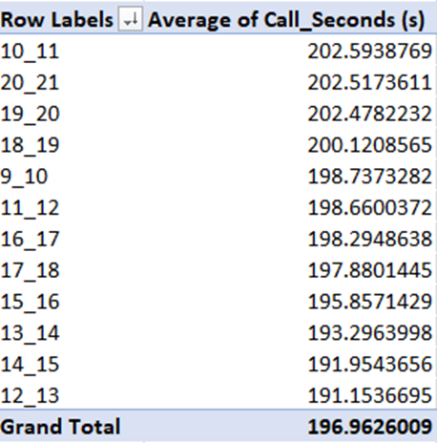
Average Call Duration For Each Time Bucket
Below is the pivot table showing the average call duration for each time bucket:

Slide 7
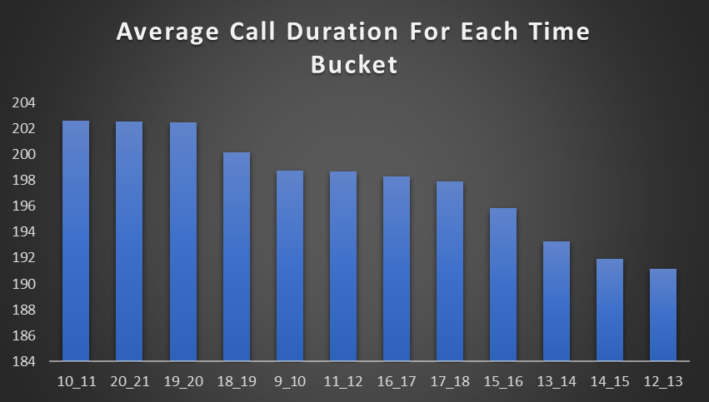
Insight Gained
After the analysis, it has been found that average call duration is maximum between 10 am to 11 am and between 8pm to 9pm and minimum between 12pm and 1pm.

Slide 8
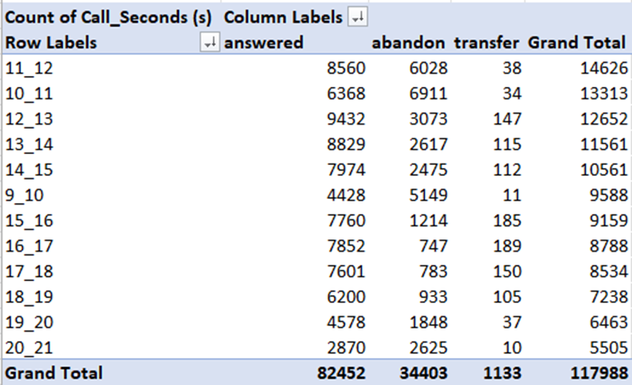
2. Call Volume Analysis
Below is the pivot table showing the count of calls received in each time bucket:

Slide 9
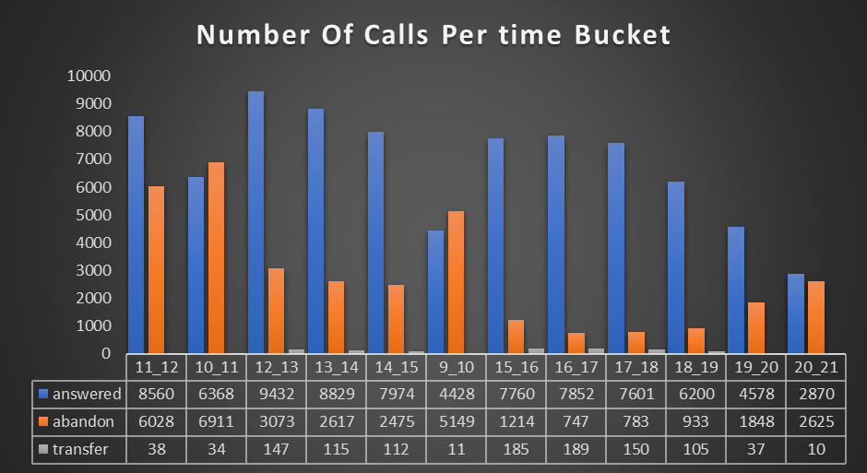
Insight Gained
After the analysis, it has been found that maximum number of calls are answered between 12pm to 1pm time bucket, and lowest are answered between 8pm to 9pm. Also, maximum number of calls are abandoned between 10am to 11am and least are abandoned between 4pm and 5pm. So, it seems that during the morning hours only most of the calls are abandoned that needs to be improved by the company.

Slide 10
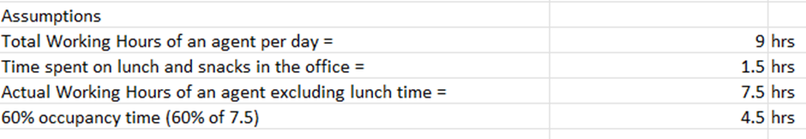
3. Manpower Planning For Day Shift
We need to provide the minimum number of agents required to reduce abandon rate to 10%. In other words, how many agents are required to increase the answered rate to 90%. Some assumptions has been provided about the agent:

Slide 11
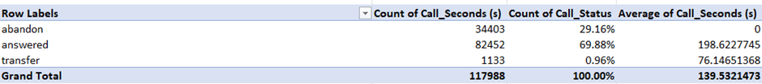
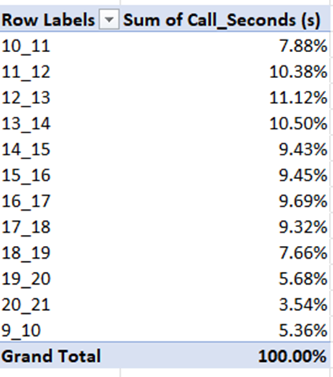
Pivot tables used for these calculations:

Slide 12
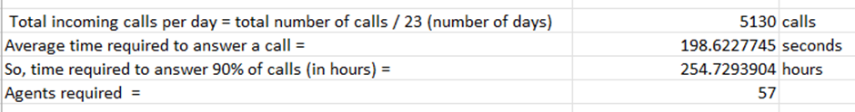
First, we calculated
Total incoming calls per day = total number of calls / 23 (as the provided data is for 23 days) = 5130 calls
Average time required to answer a call = average of call seconds(s) for answered calls only = 198.62 seconds
Time required to answer 90% of calls (in hours) = total incoming calls per day * average time required to answer a call * 0.9 / 3600(convert to hours) = 254.72 hours
So, total agents required to answer 90% of calls = time required to answer 90% of calls (in hours) / 4.5 (i.e occupancy time) = 57

Slide 13
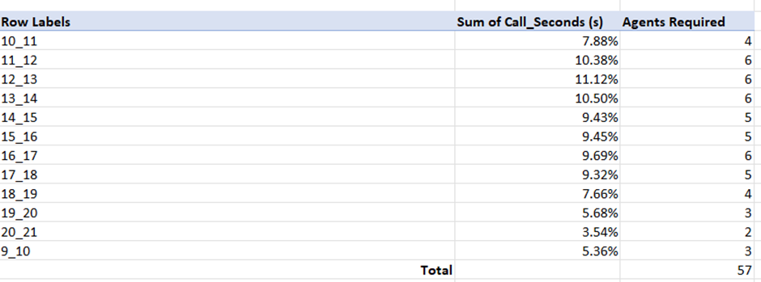
Now, number of agents required for each time bucket = total number of agents * percentage count of call seconds(s)
Insight Gained
After the analysis, in total 57 more agents are required to answer 90% of calls and the above screenshot is also showing the number of agents required for each time bucket.

Slide 14
4. Night Shift Manpower Planning
Customers also call ABC Insurance Company at night but don't get an answer because there are no agents available. This creates a poor customer experience. Assume that for every 100 calls that customers make between 9 am and 9 pm, they also make 30 calls at night between 9 pm and 9 am. The distribution of these 30 calls is given as follows:

Slide 15
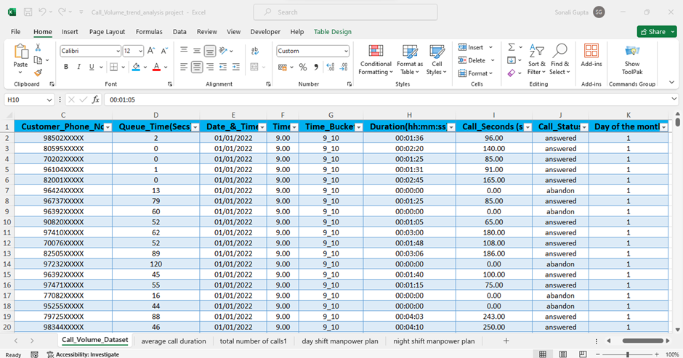
I need to propose a manpower plan for each time bucket throughout the day by keeping the maximum abandon rate at 10%.
To do this, I first created a column named day of the month using day() in excel which gives the day of the month using date_&_time column given the dataset.

Slide 16
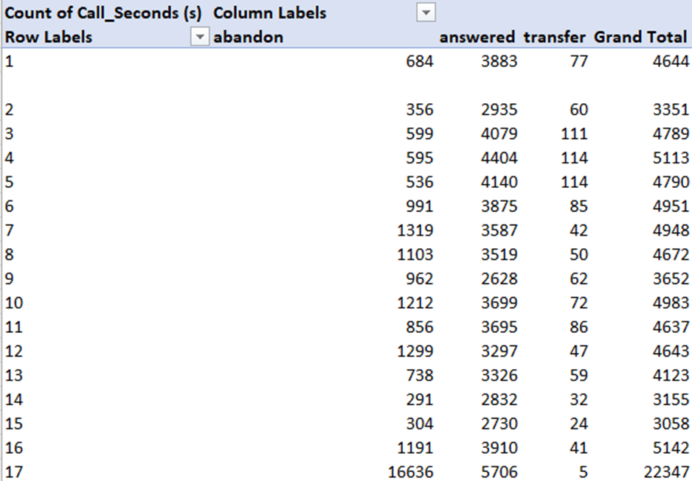
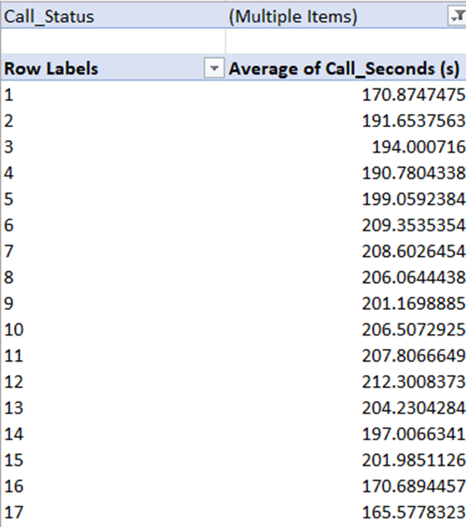
Same assumptions of the day shift will be taken for the night shift too:
Pivot tables used for the manpower planning:

Slide 17
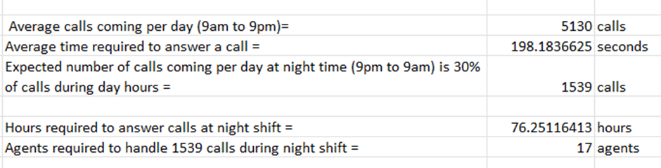
Now, we calculated
Total incoming calls per day = 5130 calls
Average time required to answer a call = average of call seconds(s) for each time bucket = 198.18 seconds
Expected number of calls coming per day at night time (9pm to 9am) is 30% of calls during day hours = 1539 calls
Hours required to answer calls at night shift = number of calls coming during night time * average time required to answer a call * 0.9(we need to answer 90% of calls) / 3600( converting it to hours) = 76.25 hours
So, total agents required to answer 90% of calls during night time = time required to answer 90% of calls (in hours) / 4.5 (i.e occupancy time) = 17

Slide 18
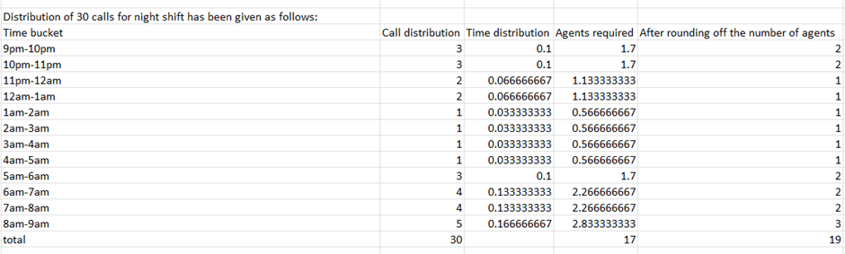
Now, we can calculate the number of agents required to answer the call during night shift for each time bucket = total number of agents required * time distribution for each time bucket
Insight Gained
After the analysis, in total 17 more agents are required to answer 90% of calls during the night shift and the above screenshot is also showing the number of agents required for each time bucket during night shift.

Slide 19
Insights
After the analysis, various insights has been found:
1) The company requires 17 to 19 more agents to handle 90% of calls during night shift.
2) The company required 57 more agents to answer 90% of calls during day shift.
3) The staffing issue can be solved by hiring new agents for day shift and by changing the shift of some of the day staff to night shift.
4) As, the company’s peak hours are during morning and afternoon, then they can shift the evening staff to this time of the day.
5) Also, some of the morning staff should start their shift early at 5am instead of 9am to reduce abandon rate.
6) Overall, the company should create 3 shifts that are morning, evening and night so that they can provide 24/7 support to their customers.

Slide 20
Project Link:
Google Drive Link For The Project
Project’s Excel Sheet Link

Slide 21
Thank You

